Slide 1
Secure Bank Cloud-Native Serverless Online Banking System

Slide 2
Description
Imagine a growing regional bank that wants to modernize its services and reach a broader customer base. They decide to create an online banking platform that allows customers to manage their accounts securely from anywhere, at any time. The bank needs a scalable, reliable, and cost-effective solution that can handle fluctuating traffic and maintain the highest security standards.
1.Scalability: AWS services like Lambda automatically scale to handle varying loads, perfect for handling peak usage times without overprovisioning.
2.Security: AWS provides robust security features and compliance certifications crucial for handling sensitive financial data.
3.Cost-effectiveness: Pay-as-you-go pricing model ensures you only pay for the resources you use.
4.Managed services: AWS RDS reduces the operational overhead of managing a database.
5.Global reach: AWS's global infrastructure allows for low-latency access for customers worldwide.
6.Integration: Easy integration between various AWS services creates a seamless development and deployment experience.

Slide 3
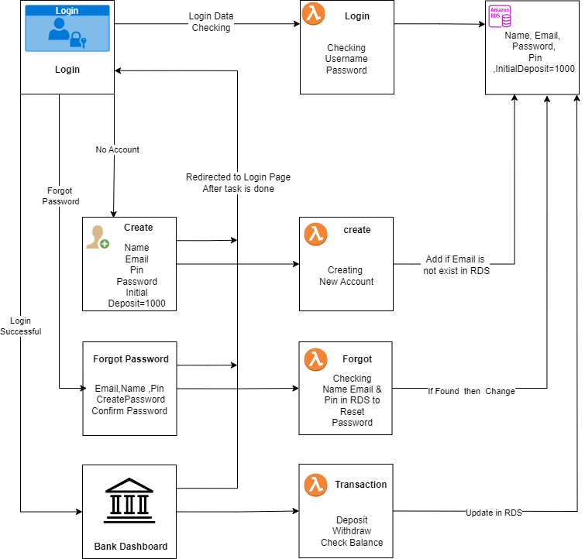
Flowchart of the Project

Slide 4
Services used for Project
1.AWS Lambda
1.Triggers
2.Cloud Watch Logs
2.S3 (Simple Storage Service)
1.Bucket
3.AWS RDS
1.Database
2.CloudWatch Metrics ,Logs & Events
4.Dbeaver(To Display data in RDS)

Slide 5
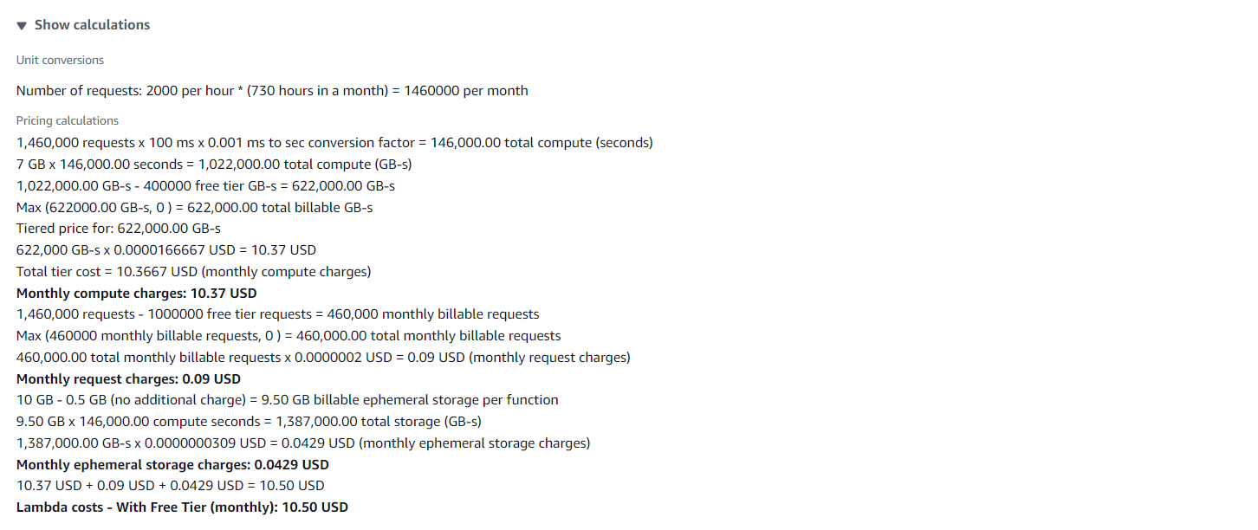
Pricing - AWS Lambda

Slide 6
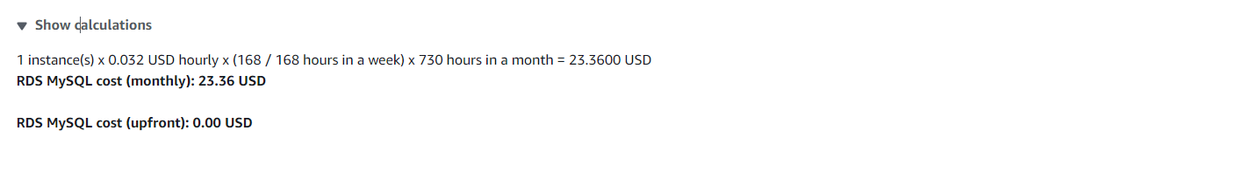
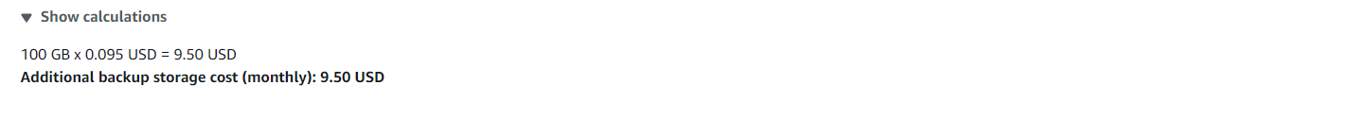
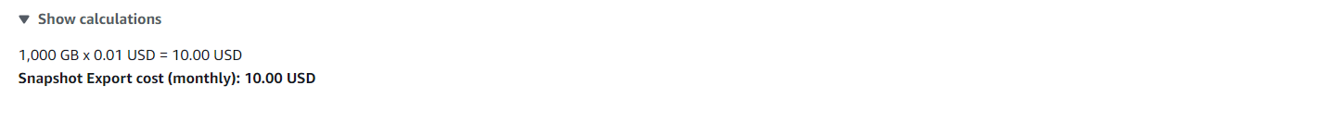
Pricing - AWS RDS

Slide 7
1.Sign-in to AWS Root Account
1.Search for AWS Management Console in Browser.
2.Open to the AWS Management Console.
3.Click on “Sign In to the Console”.
4.Choose “Root user” as the login method.
5.Enter Email and Password that is associated with your AWS root account.
6.Click on Sign in.

Slide 8
2.SettingUp Lambda
1.Search for Lambda in Search bar and open Lambda dashboard.
2.Click on Create Lambda Function , Assign a Name to Lambda & Runtime(Language) , Select Architecture as x86_64 , Click on Create a new role with basic lambda Permissions , Create.
3.Click on Add Trigger , Search for API Gateway , in intent block - checkmark on Create new API , in API type block select REST API , in Security dropdown select Open and Add it.
4.Click on Code in Lambda Function , Click on Upload from , select the ZIP file ,click on “Upload to” Upload the zip file in Lambda function & the code will be Deployed if not Click on Deploy.
5.Click on Configuration in Lambda Function to get API Endpoint & Copy it.
6.Open VScode, Paste the API Endpoint in JavaScript code , Open the website ,enter the data that has to send to Lambda & , Click on button to Hit a request to Lambda Via API Gateway from website.

Slide 9
7.Click on Monitor in Lambda Function ,Click on view Cloud Watch Logs & Open Log groups – “aws/lambda/lambda_name” to watch the logs of the created Lambda Function.
8.We can see the logs of Hitting Request to Lambda via API Gateway from Website of Local Host.
9.When we hit a request from Website to lambda through API Gateway’ end point then API Gateway will receive a request from Website with data & that came in raw body to Lambda Function.

Slide 10
2.1 SettingUp Createlambda
Use of Create Lambda:
1.It is used to take the data of creation of an account from website to AWS Lambda.
2.If any data is missed then it returns missing data field.
3.It Takes data Full Name, Email, Pin, Password, Initial Deposit when create button is clicked it send data to AWS Lambda then lambda connects to RDS.
4.Full Name is must filled field, if Email entered already exits it returns account already created with this email& email should be in xxxx@gmail.com format, pin should be 4 digits, initial deposit should be minimum ₹1000 or more , Password should contain 8 characters with consists of 1 Capital[A-Z], 1 Small letter[a-z], 1 Number[0-9], & a special character[@,$,&,*,!].
5.AWS Lambda sends the data to AWS RDS database & stores the data in the table.
6.If all done without any error then it will return Account Created Successfully in the Website.
7.After creation of account it will direct to Login page.

Slide 11
2.2 SettingUp Loginlambda
Use of Login Lambda:
1.It is used to take the data of Login page from website to AWS Lambda.
2.If any data is missed it returns missing data field.
3.It Takes email & password, when login button is clicked it sends the data to AWS lambda & then lambda connects to RDS.
4.If email does not match in database then it returns Invalid Email.
5.If password doesn’t match in database for Corresponding email then it returns Invalid Password.
6.If both email & password are wrong then it returns Invalid Credentials.
7.In RDS ,it Checks if the email exists in database or not, if exists then checks the corresponding password, if both matches it is directed to dashboard of website.

Slide 12
2.3 Forgotlambda
Use of Login Lambda:
1.It is used to take the data of forgot page from website to AWS Lambda.
2.If any data is missed it returns missing data field.
3.It Takes data of email ,name, pin with new password & then sends to AWS lambda when submit button clicked then lambda connects to RDS.
4.If any of these doesn’t match in database then it returns data not found to website.
5.It first checks the email and then corresponding name and at last the corresponding pin, if all these three matches in the database the new password is replaced with old password in database.
6.It returns Password changed successfully for email to the website.

Slide 13
2.4 SettingUp Transactionlambda
Use of Transaction Lambda:
1.It is used to take the data of Dashboard of bank page from website to AWS Lambda.
2.If any data is missed it returns missing data field.
3.After login we have 3 options Deposit, Withdraw, Check Balance.
4.If Deposit is entered and clicked on submit button and it check the email , password in database if matched it adds the deposit amount to existing balance and return the statement to website.
5.If Withdraw is entered and clicked on submit and check the email , password in database, if matched it checks the Withdraw amount is less than balance in the account if there then it subtracts the withdraw amount from existing balance and return the statement to website.
6.If Check Balance is entered and clicked on submit button and check the email , password in the database if matched it takes yes or no and returns the balance to website
7.When Submit is clicked the data is taken to AWS Lambda & then lambda connects to RDS and returns the output to website.
8.Exit button directs you to login page.

Slide 14
4.SettingUp S3 for Hosting
1.Search for S3 in Search bar and open S3 dashboard, Click on Create Bucket.
2.Select the bucket type as General Purpose, Give Unique bucket name to your bucket.
3.Checkmark on Block All public Access, Select ACL’s disable in Object Ownership & Create on Bucket.
4. Select the S3 Bucket ,Click on Objects ,Click on Upload & Choose the files from your PC.
5.Click on file to be uploaded (Html CSS JS) and Click on Upload.
6.When we use the Object URL of this file in S3 bucket it will be only available for your Private users.
7.If the Public Users wants to access the website.
8.Select the file in S3 bucket ,Click on permissions, Uncheck mark the “Block all public access” to convert into Public ,Copy the Bucket ARN number & Click on Edit on Bucket Policy.

Slide 15
9.Select S3 bucket policy in Select Policy type ,Click on Allow Effects & Type * in Principles.
10.Check mark All Actions , Paste the Bucket ARN and enter /* after Bucket ARN.
11.Click On Add Statement & Click on Generate Policy.
12.Copy the code from AWS Policy and Paste it in Bucket Policy & Save it.
13.Bucket Policy edited Successfully.
14. Now public users can access our website by Object URL.

Slide 16
5.Setting Up RDS
1.Search for RDS in Search bar and open RDS dashboard, Click on Dashboard.
2.Click on Create Dashboard ,Select Standard Create in Choose Database Creation Method & Select Engine of database.
3.Select Free Tier in Templates , Give Name to database, Create Username & Create Master Password for database in Credential Settings.
4.Select the Instance type, Storage & Select default VPC ,Checkmark Yes in Public Access.
5.Select default Security Group & Choose Availability Zone.
6.Enable Enhance Monitoring In Monitoring & Click on Create.
7.Database is created , Open database , Click on Connectivity & Security.
8.Click on VPC Security groups, Click on default group ,it will direct us to Security group details.
9.Click on Inbound rules , Click on edit Inbound rules & Click add rules – Select Custom TCP with port number 3306(Database port number) & Click on save.
10.Copy the Endpoint of the Database. (Paste it in Lambda & Dbeaver).

Slide 17
6.DBeaver
1.Install DBeaver & Open.
2.Click on connect to database logo, Search for our Database Engine & Click Next.
3.Paste the Database Endpoint URL in Server Host, Enter the Username, Password & Click on Test Connection.
4.Click on ok & then Finish to Established Connection between RDS Database & Dbeaver.
5.Expand Database-1,Right Click on New Database & Enter Database name Click on ok.
6.Expand data1,Right click on it ,Select SQL editor & Open SQL Script.
7.To create a table in formdata1 database , copy the query1 in the script.
8.Run the SQL query , Table has been created & Expand the tables in formdata1 database.
9.To display the table Copy the query2 in the Script & Run the query then table is displayed.
10.Table is Created.

Slide 18
Query-1
CREATE TABLE users (
name VARCHAR(100) NOT NULL,
email VARCHAR(255) PRIMARY KEY,
pin INT NOT NULL,
password VARCHAR(255) NOT NULL,
initialDeposit DECIMAL(10, 2) NOT NULL
);
Query-2
SELECT * FROM users;

Slide 19
Working of Website

Slide 20
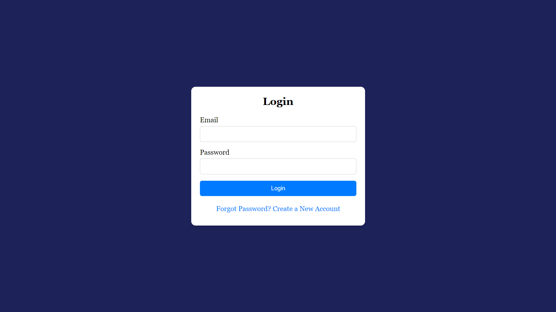
7.1 Login Page.

Slide 21
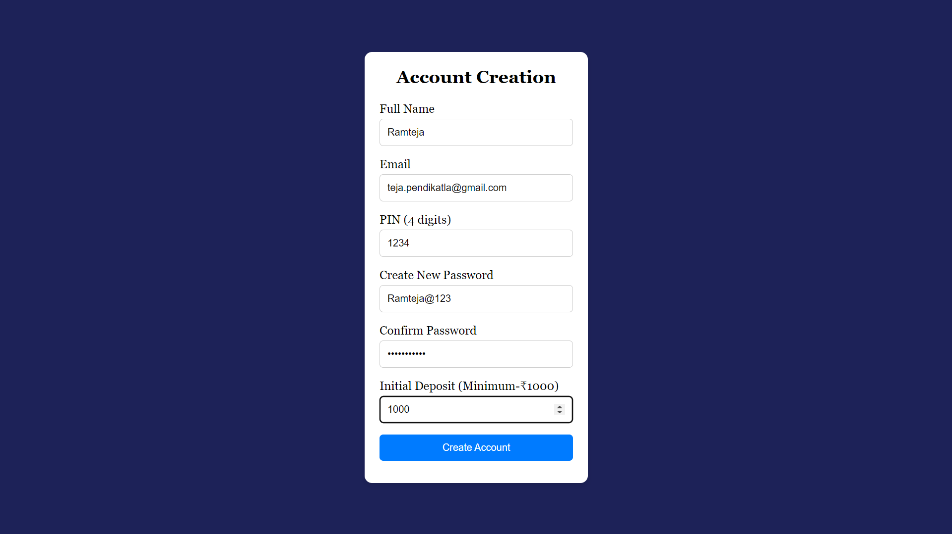
7.2 Account Creation.

Slide 22
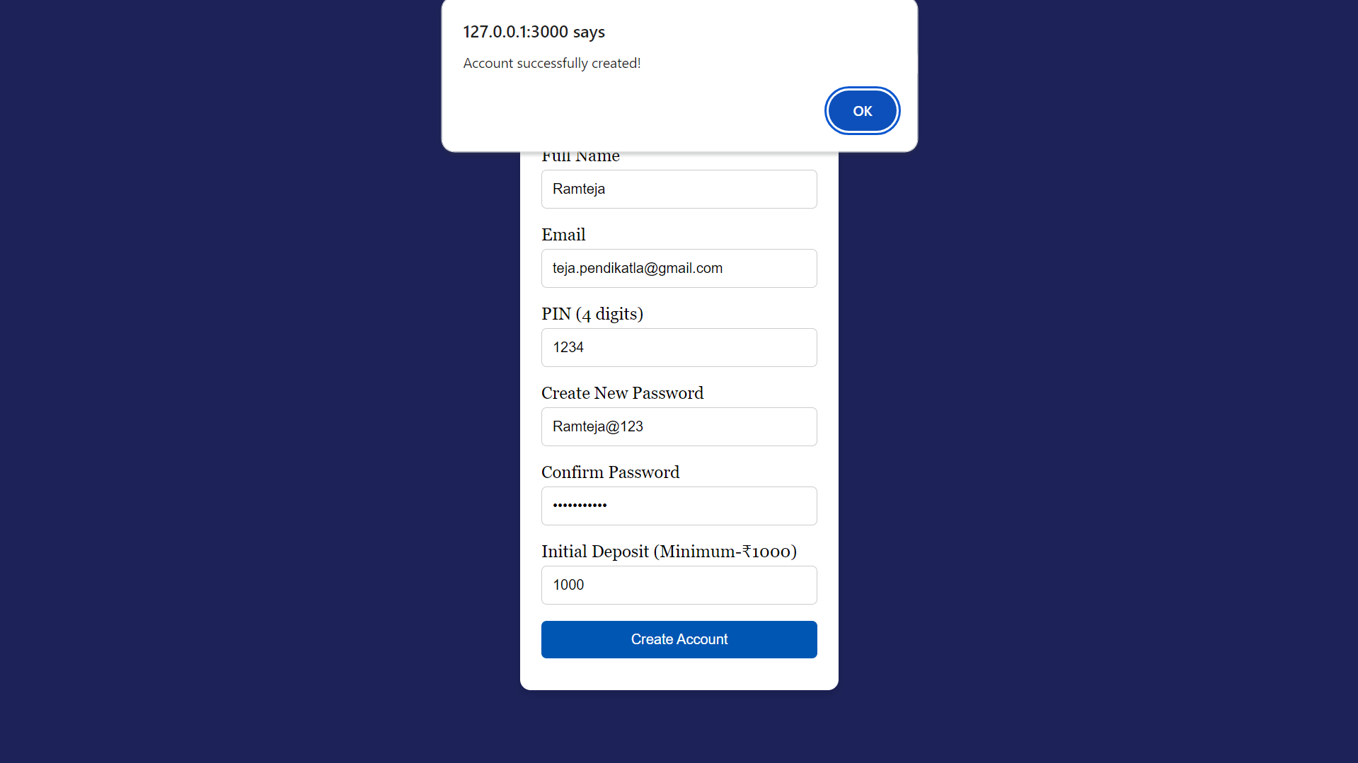
7.3 Account Created Successfully.

Slide 23
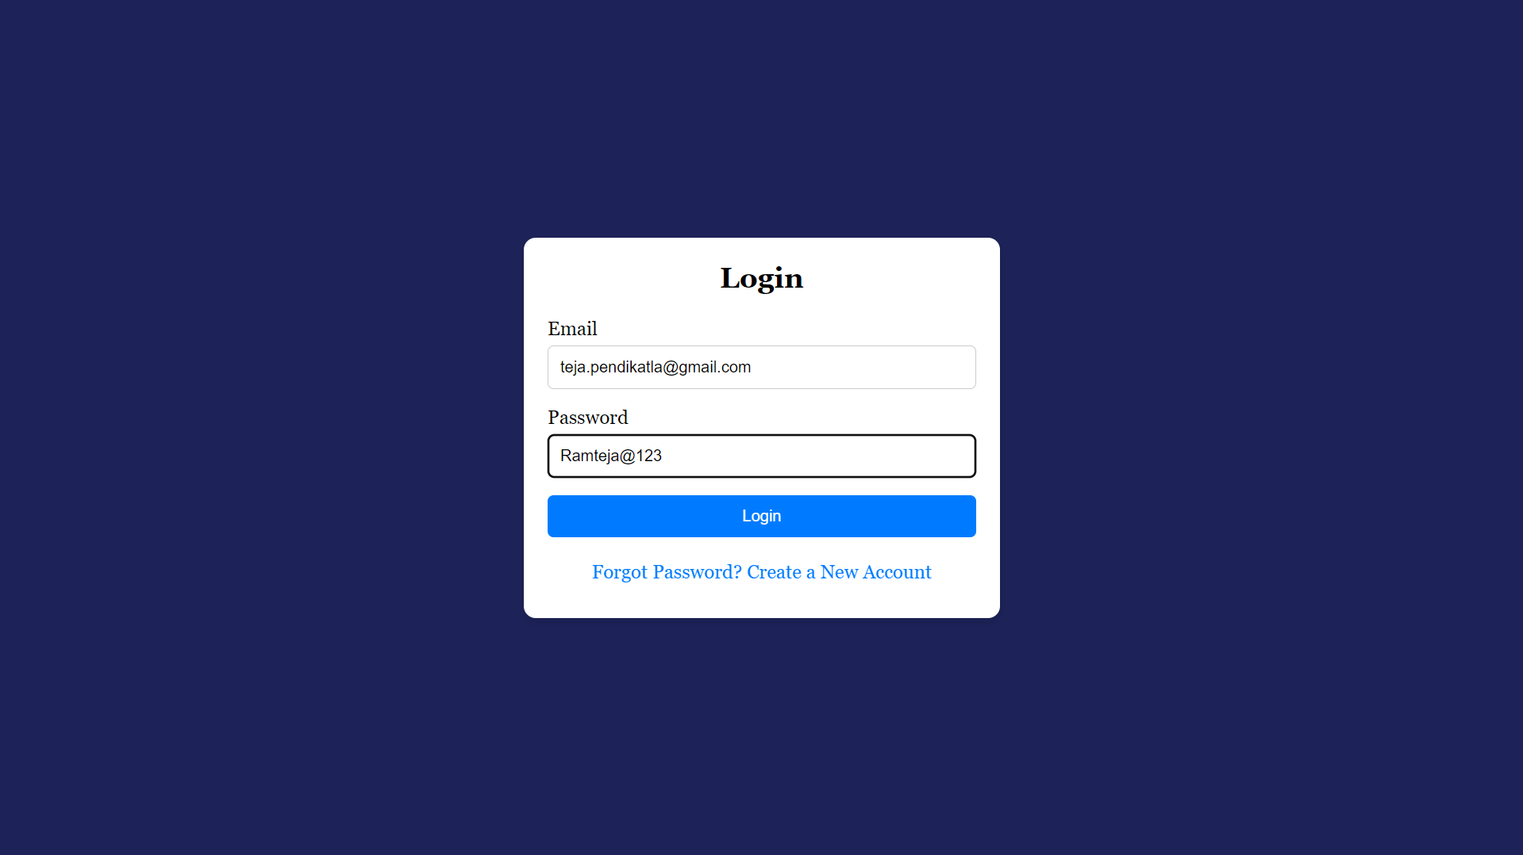
7.4 Enter Login Details.

Slide 24
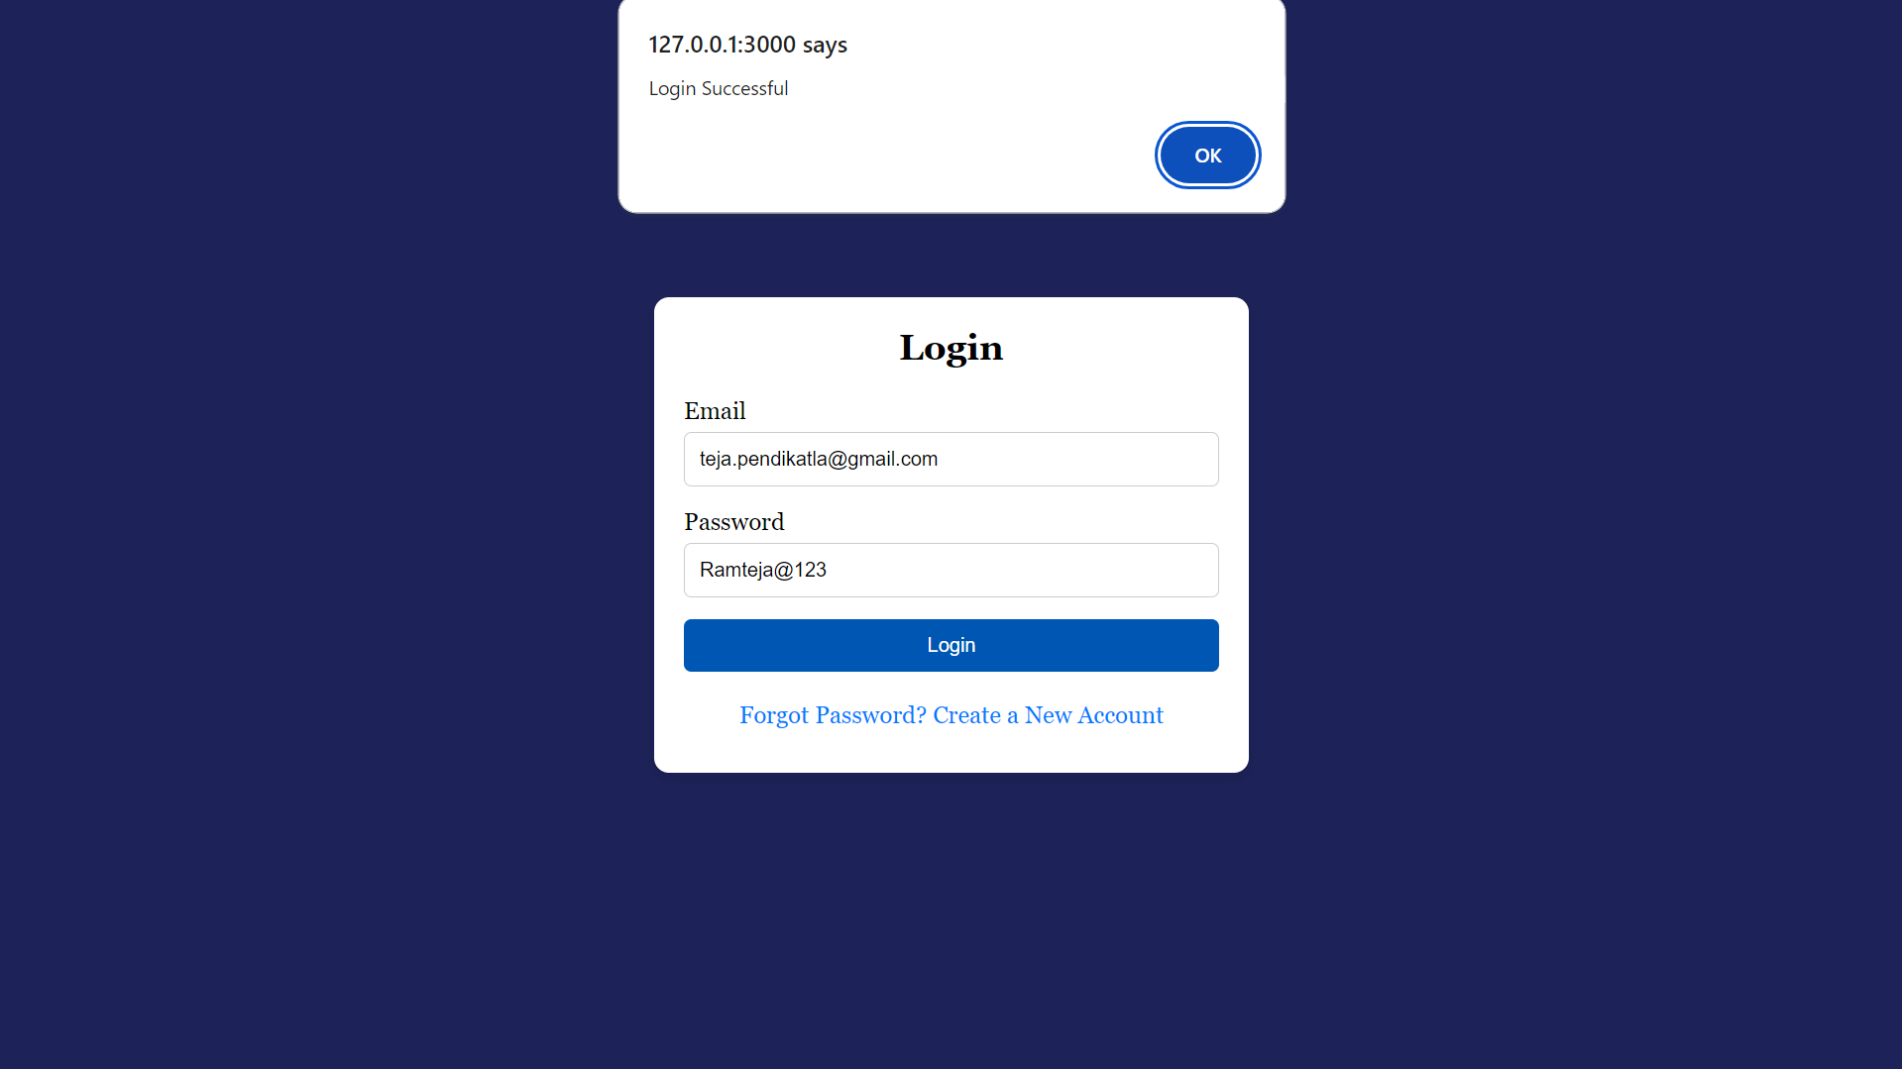
7.5 Login Successful.

Slide 25
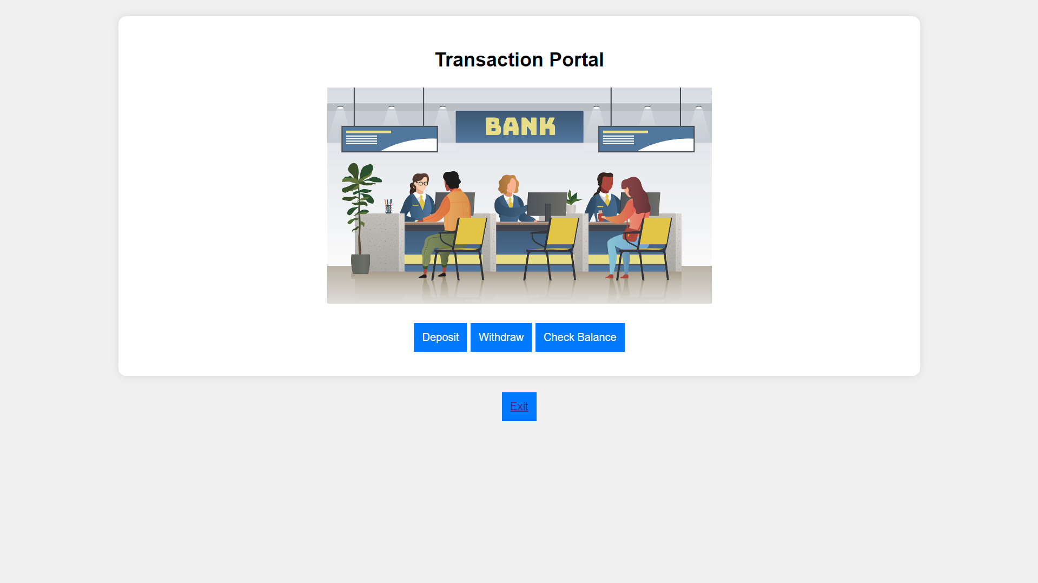
7.6 Bank Website Dashboard.

Slide 26
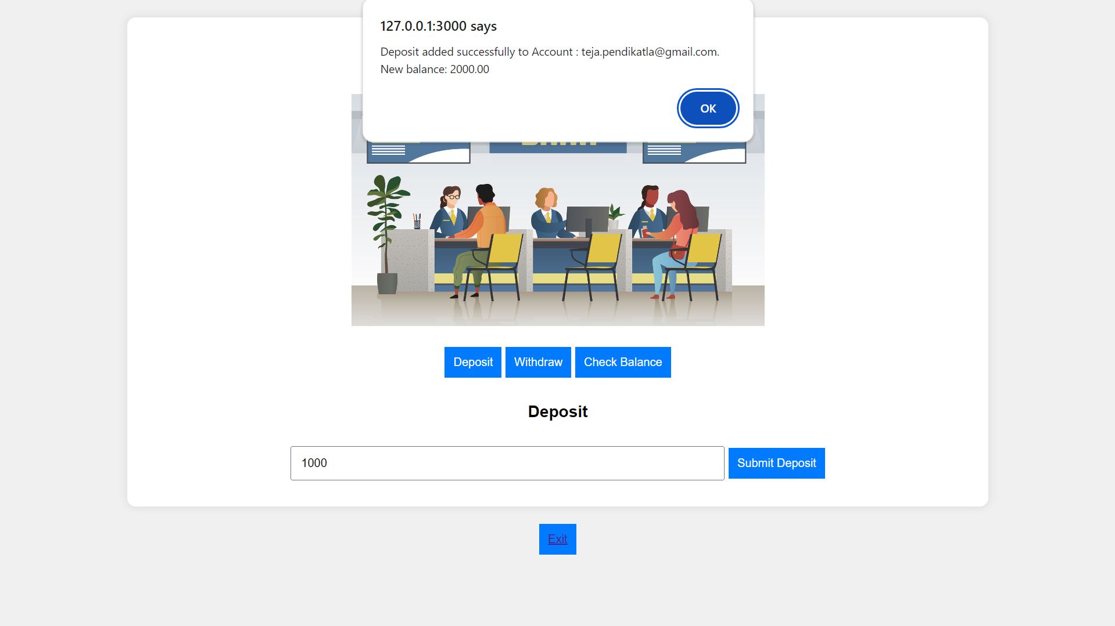
7.7 Deposit Added Successfully.

Slide 27

7.8 Withdraw Successful.

Slide 28
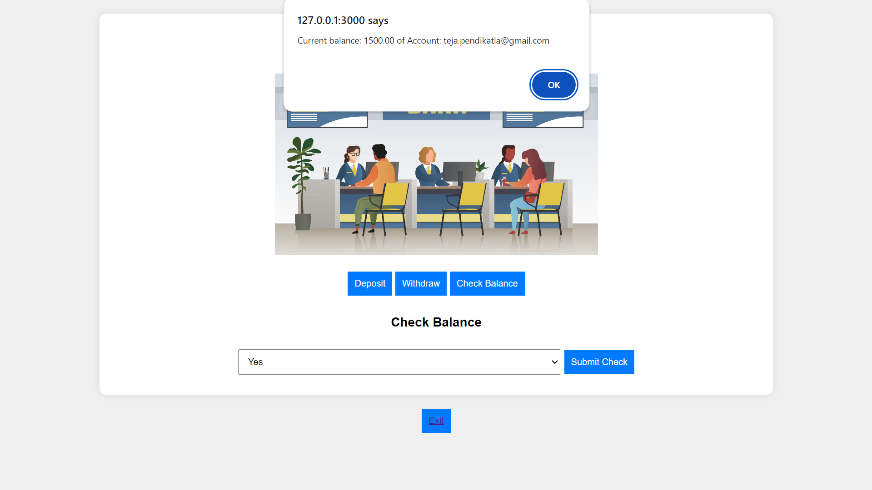
7.9 Checking Balance in the account.

Slide 29
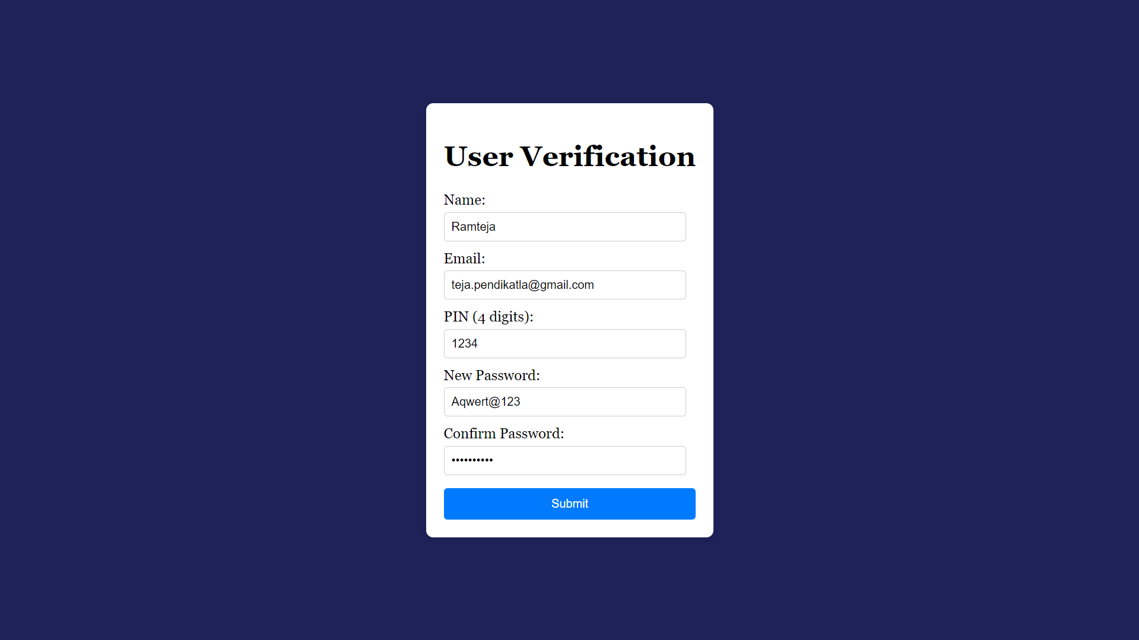
7.10 Password Reset Process

Slide 30
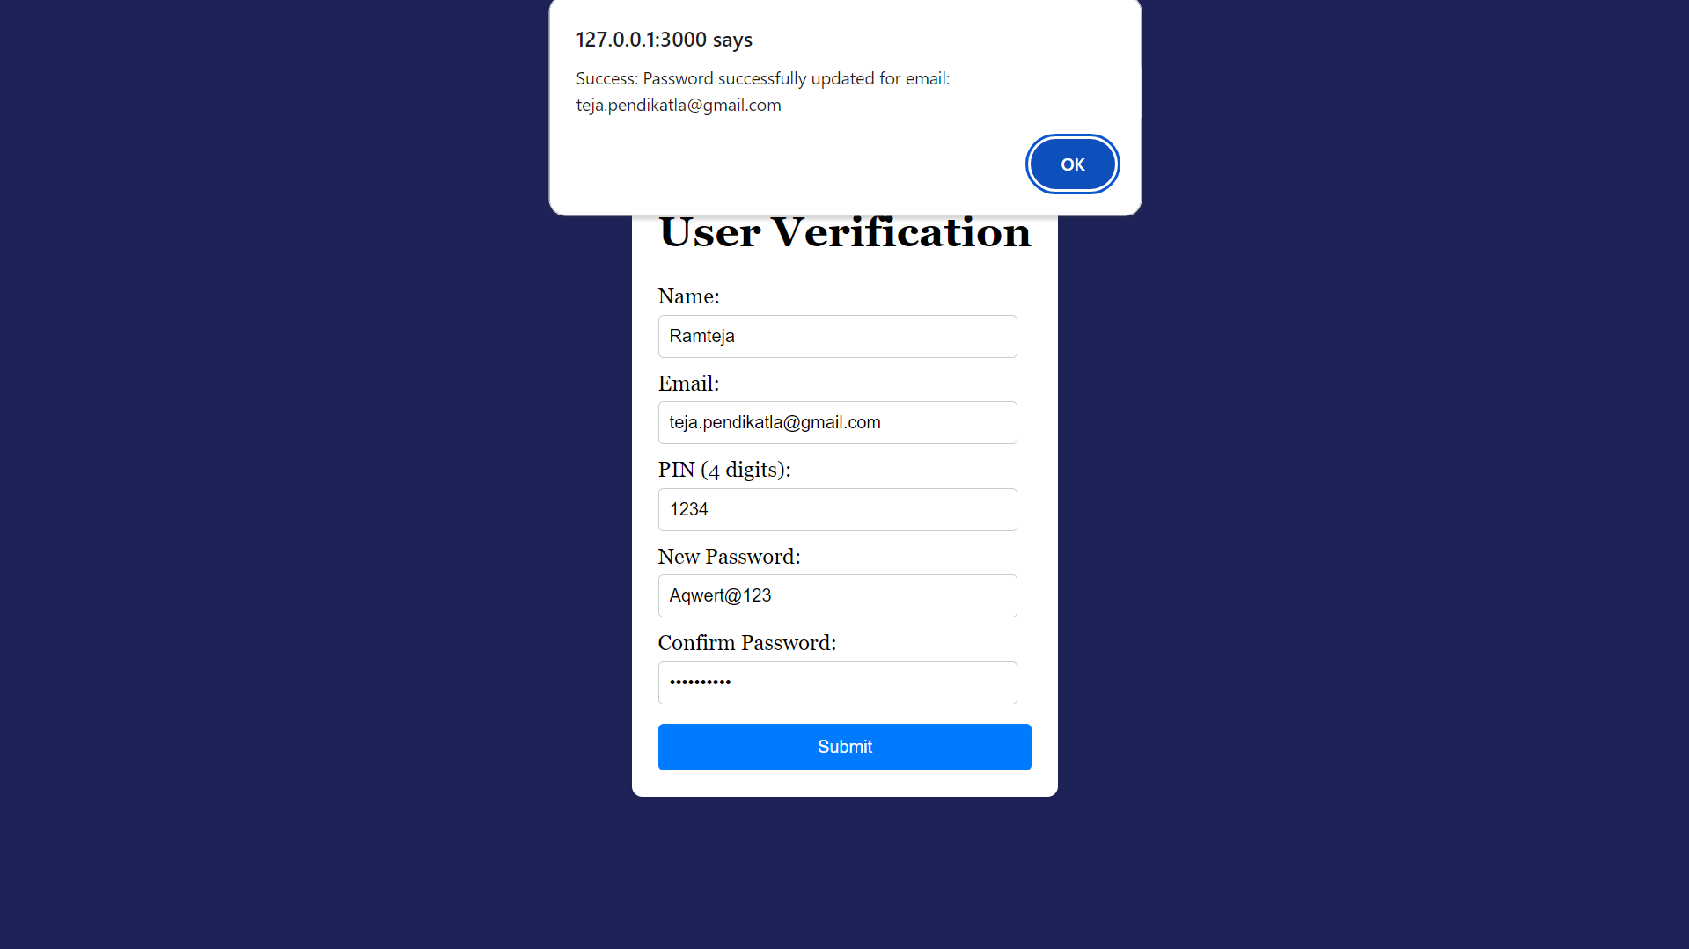
7.11 Password Updated Successfully.

Slide 31
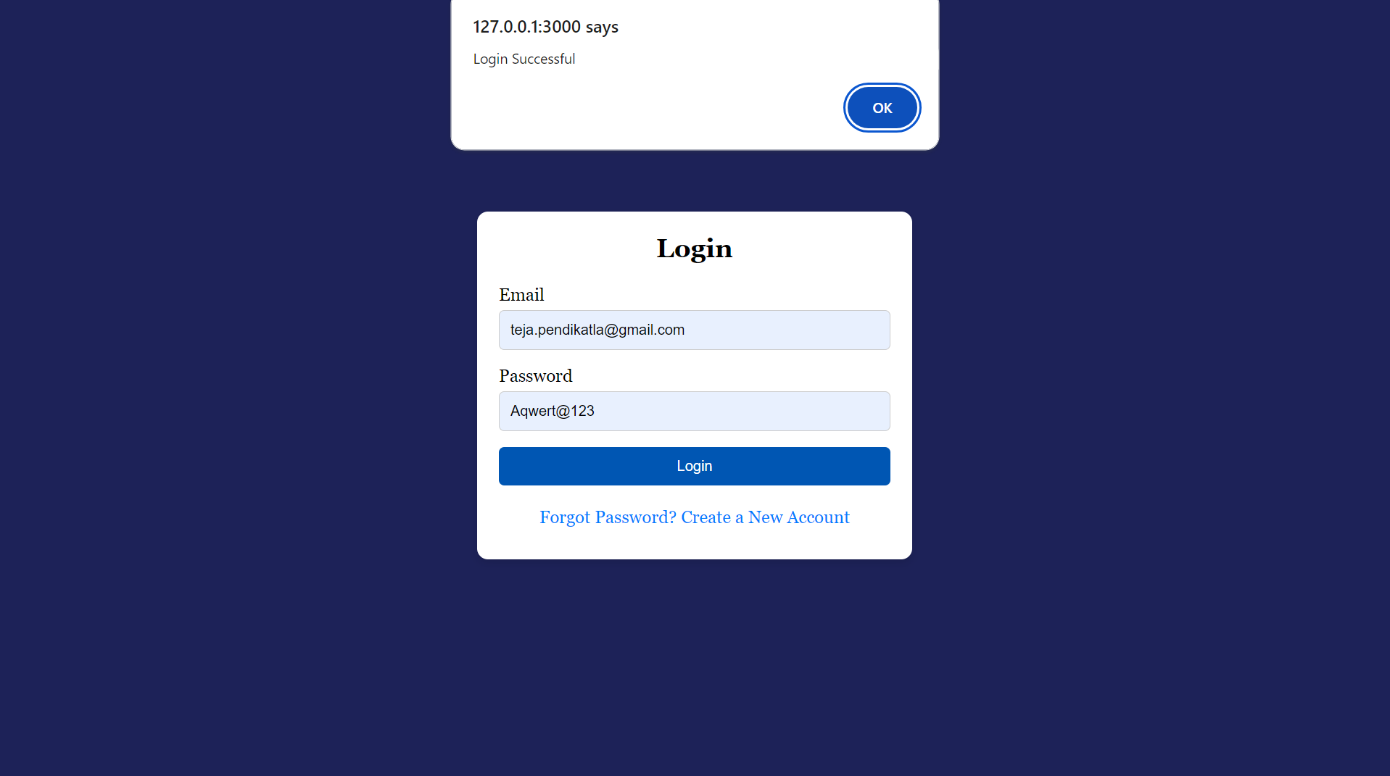
7.12 Login Successful with new password.

Slide 32
8.Monitoring
1.Monitoring Database
1. RDS Logs & Events.
2. Cloud Watch Metrics of RDS.
3. Maintenance , Backup & Snapshots in RDS.
2.Monitoring Lambda Function
1. Cloud Watch Logs for Lambda.
2. Detailed information of Request from Website to RDS.
3. Some logs of Website taking Data Successfully.

Slide 33
Uses of This Project
Provide 24/7 banking services to customers, improving accessibility and satisfaction.
Reduce operational costs associated with physical branches.
Attract tech-savvy customers and expand market reach.
Streamline banking operations through automation.
Key features
Account creation for new customers.
"Forgot password" functionality with secure reset process.
Dashboard displaying account balances.
Deposit and withdrawal capabilities.
Real-time balance checking.

Slide 34
Conclusion
SecureBank represents a significant step forward in digital banking, leveraging the power of AWS to create a secure, scalable, and user-friendly online banking experience. By embracing cloud technologies, banks can stay competitive in an increasingly digital world, meeting customer expectations for convenience and security. The system's use of advanced AWS services like Lambda and RDS enables real-time processing and data management, offering customers instant access to their financial information and transactions.
This project not only modernizes banking operations but also opens doors to future innovations in financial technology. As the financial landscape continues to evolve, cloud-native solutions like Secure Bank will play a crucial role in shaping the future of banking.

